Slide 1
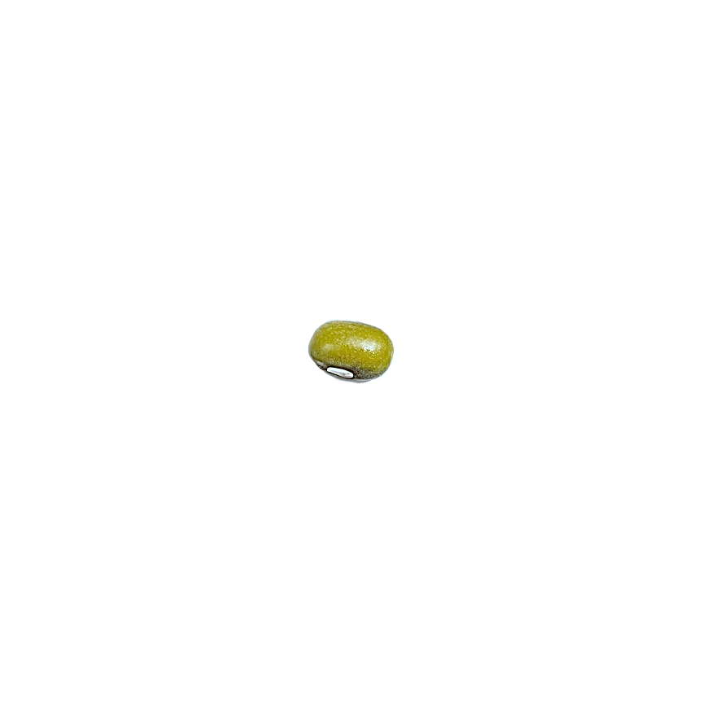
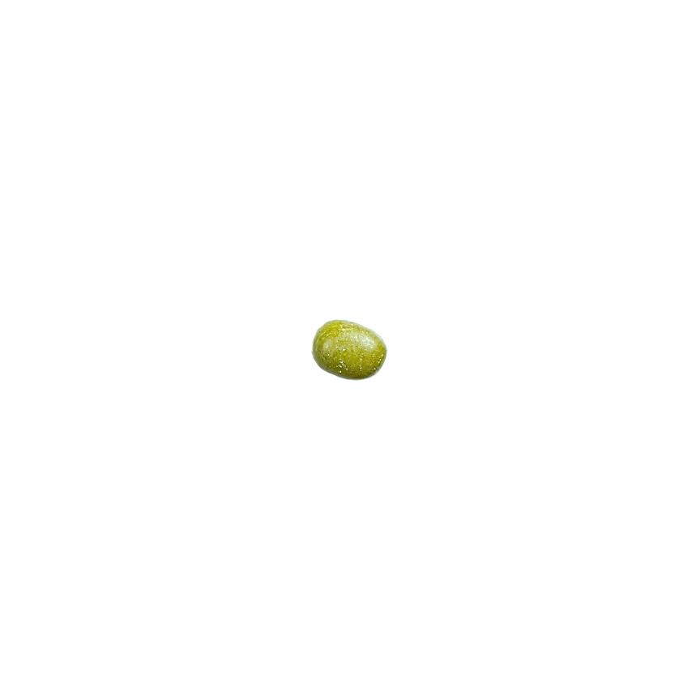
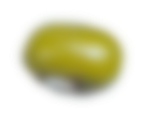
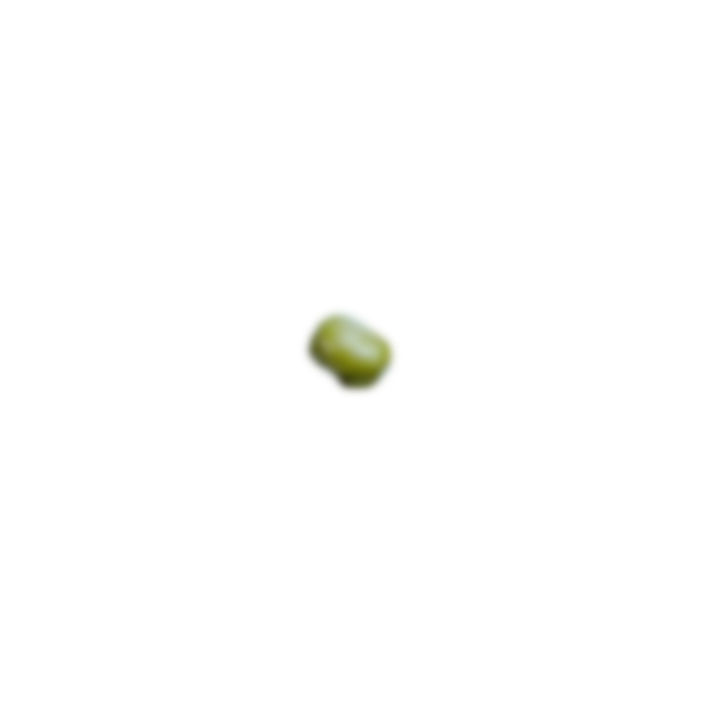
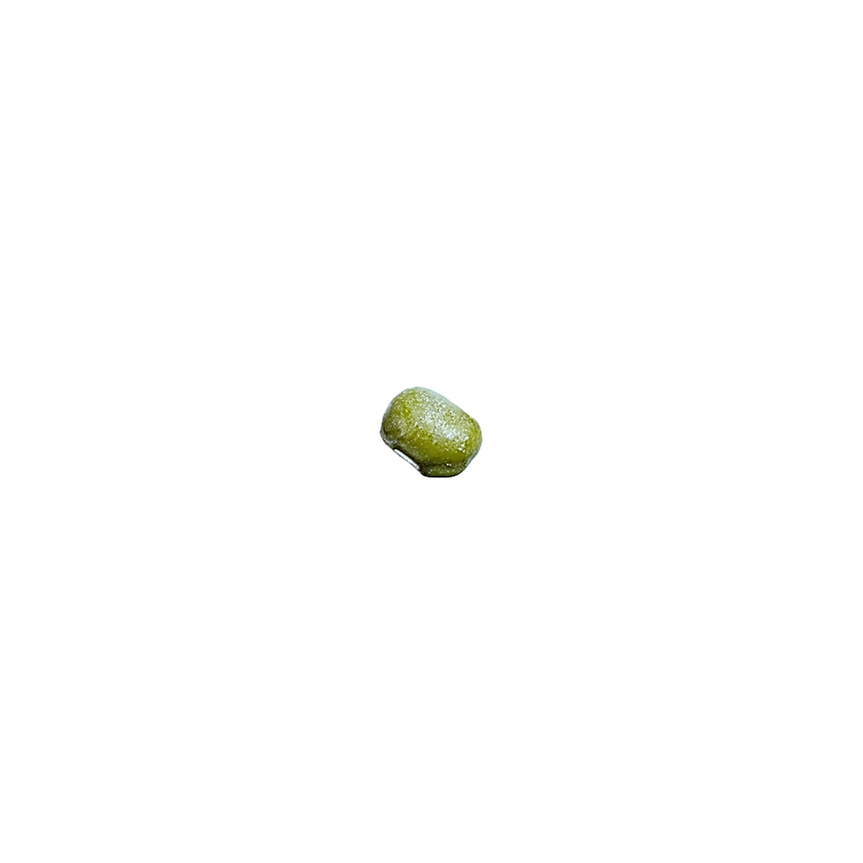
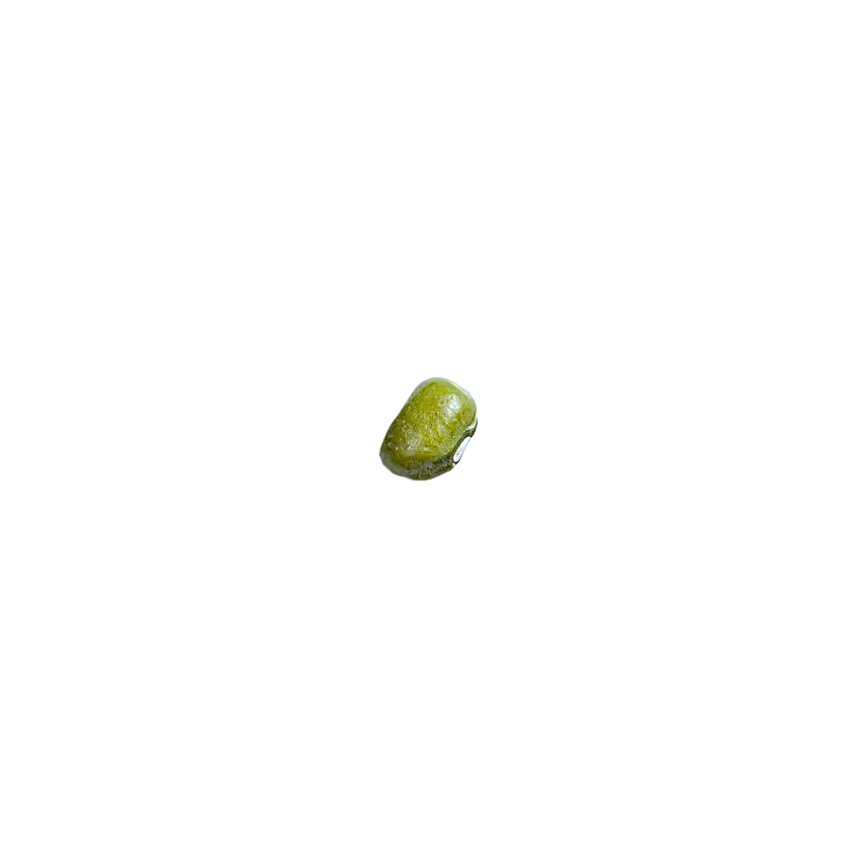
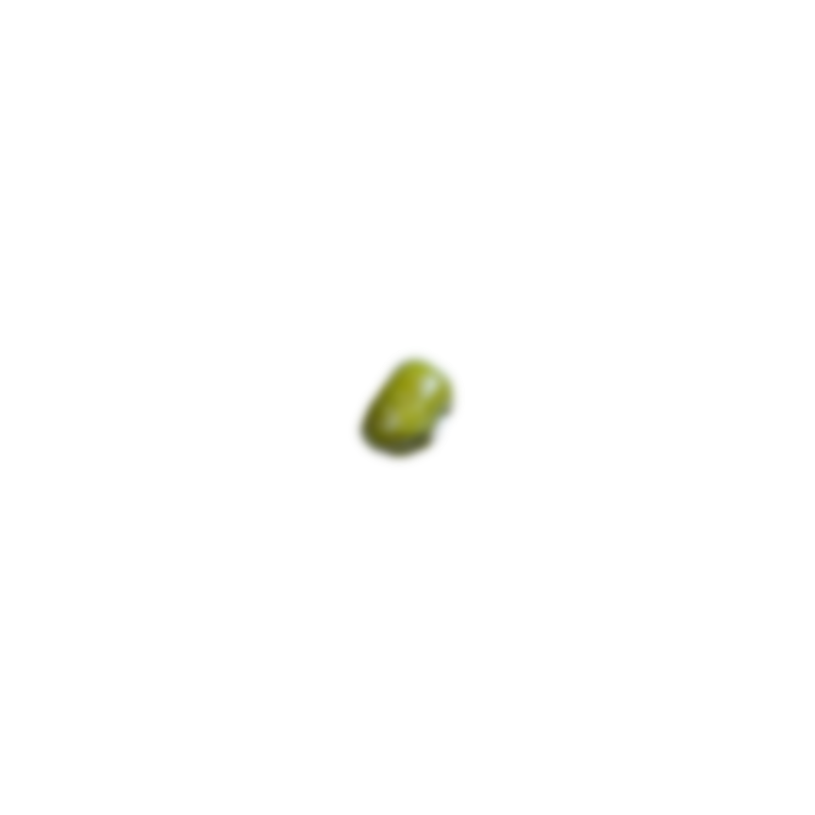
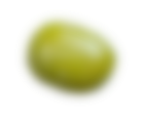
MONGODB

Slide 2
db means
database.
Yes, I store data!

Slide 3
SQL
My data are interrelated through my tables. I love making connections!
NO-SQL
Tablesssssssssssssss? One folder is enough to put all my data

Slide 4
SQL
My data are interrelated through my tables and I love making relationships!
NO-SQL
Tablesssssssssssssss? One folder is enough to put all my data

Slide 5
SQL
My data are interrelated through my tables. I love making connections!
NO-SQL
Tablesssssssssssssss? One folder is enough to put all of my data

Slide 7
mongoDB

